Slide 1


Taxi Fare Prediction
Mayuri Inde(1316)
Snehal Kolikal(1351)
Prashant Karhale Akshay Tilekar (External Guide)
Center Coordinator
Presented by:

Slide 2
Introduction
Taxi Fare Prediction
Complete Taxi data for the year 2020 consist of 10Lakh rows with 21 columns. It includes trip records from all trips completed in taxis in NYC in 2020. Records include fields capturing pick-up and drop-off dates/times, trip distances, rate id code, payment types, and driver-reported passenger counts.
We are predicting fare amount by taking the variable like pick-up and drop-off dates/times, trip distances, rate id code, payment types, total amount and passenger counts.
Linear Regression , Random Forest ,Logistic Regression and Polynomial Regression models were used .

Slide 3
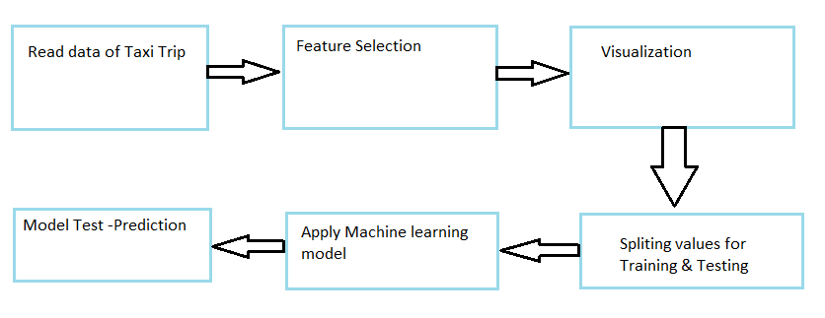
Taxi Fare Prediction
Flowchart of System:
Institute for Advanced Computing and Software Development, Akurdi

Slide 4
Technologies Used:
Taxi Fare Prediction
Python
Machine learning algorithms
Models used in the system:
Random Forest model
Linear Regression model
Polynomial Regression model
Institute for Advanced Computing and Software Development, Akurdi

Slide 5
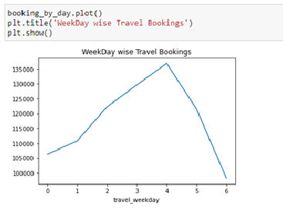
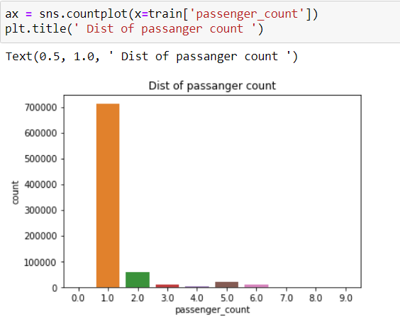
Visualization
Taxi Fare Prediction

Slide 6
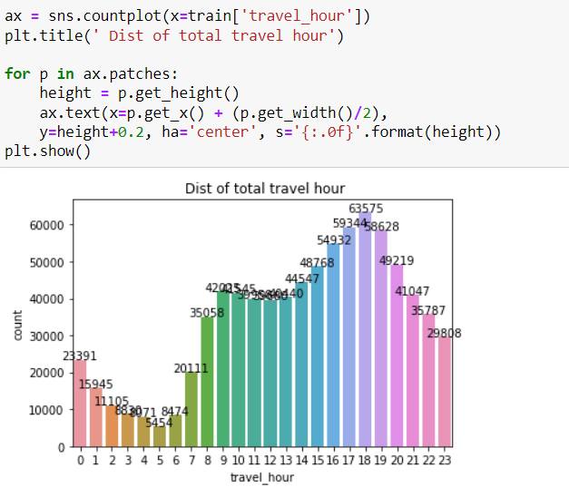
Taxi Fare Prediction

Slide 7
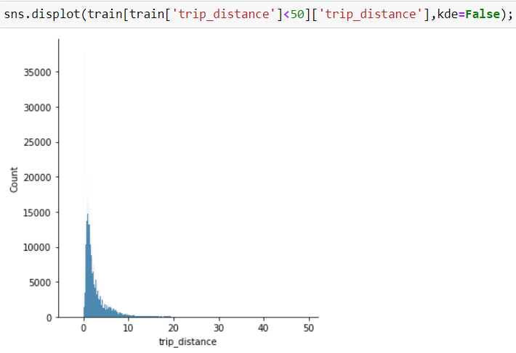
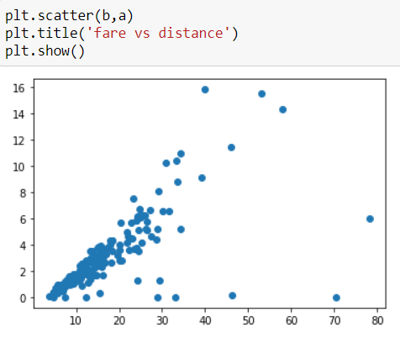
Taxi Fare Prediction

Slide 8
MACHINE LEARNING ALGORITHM
Taxi Fare Prediction
Linear Regression
Random Forest
Logistic Regression
Polynomial Regression

Slide 9
Results And Findings
Taxi Fare Prediction
Algorithm | R2_Score | RMSE
Linear Regression | 0.07357774616465473 | 126.8142601522355
Random Forest Regression | 0.07357774616465473 | 4.369182593272292
Polynomial Regression | 0.7847523177835105 | 5.431563990582172

Slide 10
Conclusion :
Taxi Fare Prediction
We had successfully predict the Fare Amount using different Independent Variables, by using various Machine Learning algorithm.
we concluded that the polynomial Regression which gave us more R2 score and less mean square error.

Slide 11
Thank You
Taxi Fare Prediction

